Slide 1
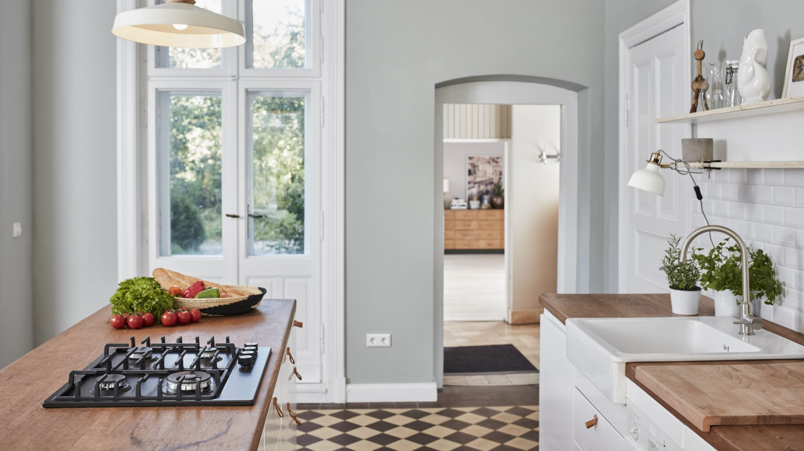
Smart-Kitchen-Helper Project
Amit Christian: 100937637
Sagar Parmar: 100942558
Shukan Thakkar: 100944139
Jinal Bambhroliya: 100964562
Arundarasi Rajendran: 100946579

Slide 2

Project Overview
The Smart-Kitchen-Helper project is a cloud-based web application designed to manage kitchen resources. It helps users track ingredients, find recipes, and access multimedia content, leveraging AWS for scalability, availability, and security.

Slide 3

Objectives
Simplified Ingredient Management
Intelligent Recipe Discovery
Enhanced Cooking Experience
Scalability and Reliability
Robust Security

Slide 4

Background: Scenario
The project addresses common challenges in kitchen management, such as ingredient tracking, meal planning, and recipe discovery. The goal is to reduce food waste and improve the cooking experience.

Slide 5
Technical Challenges
Scalability: Handling peak traffic without compromising performance.
Data Management: Efficiently storing structured and unstructured data.
Security: Protecting user data with multiple layers of security.
Integration: Managing API integrations with external services like YouTube.

Slide 6
Design Methodologies
Microservices Architecture: Scalability and maintainability.
Cloud-Native Design: Leveraging AWS services.
Data Security: Encryption and secure access controls.
Serverless Computing: AWS Lambda for API integrations.

Slide 7

Design Rationale
AWS as the Cloud Provider: Flexibility and global reach.
Multi-AZ Deployment: Ensuring high availability.
Use of MongoDB Atlas: Handling unstructured data.
NAT Gateway: Secure internet access for private instances.

Slide 8
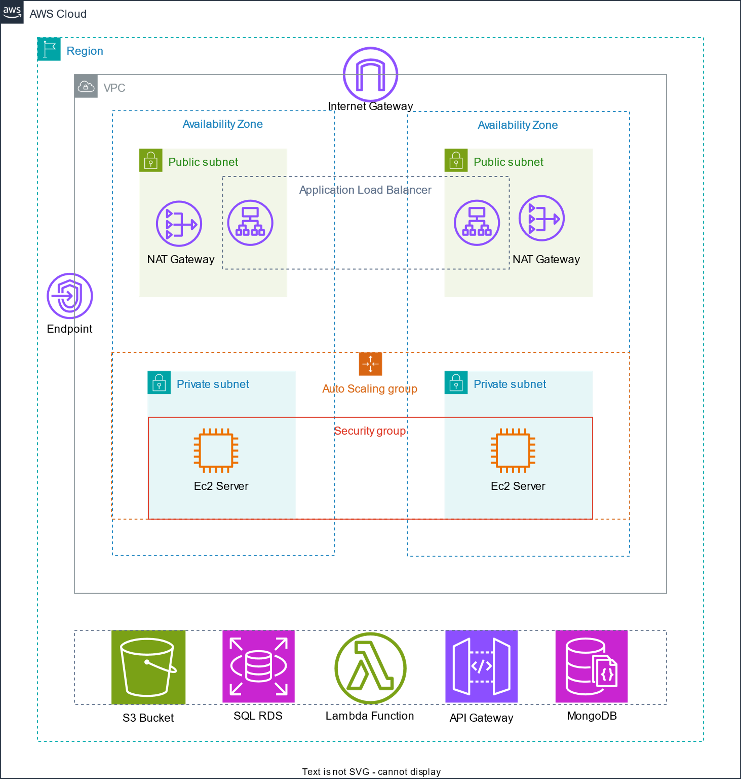
Project Architecture
AWS-based architecture with EC2, RDS, MongoDB, and Load Balancer.

Slide 9
Smart kitchen Helper- AWS Implementation Details
VPC: Custom VPC with public and private subnets.
EC2 Instances: Auto Scaling for dynamic resource management.
RDS PostgreSQL: Multi-AZ deployment for high availability.
MongoDB Atlas: Sharding and replication for scalability.

Slide 10
Current Progress
Frontend: Main pages completed; route implementations pending.
Backend: APIs implemented; Lambda integration in progress.
Database: RDS PostgreSQL and MongoDB Atlas configured.
Security: IAM roles and security groups configured; ongoing testing.

Slide 11

Conclusion
The Smart-Kitchen-Helper project leverages AWS to provide a scalable, secure, and efficient kitchen management solution. Ongoing development focuses on enhancing the user experience and ensuring robustness through continuous testing.

